Slide 1
L4/5 Group 3
Game Name
Nathaniel Berger
Henry Crofts
Heather Bishop
Alex Rosca

Slide 2
Demographics
Males & females.
Aged 18-35.
Player Types: Explorers, Achievers

Slide 3

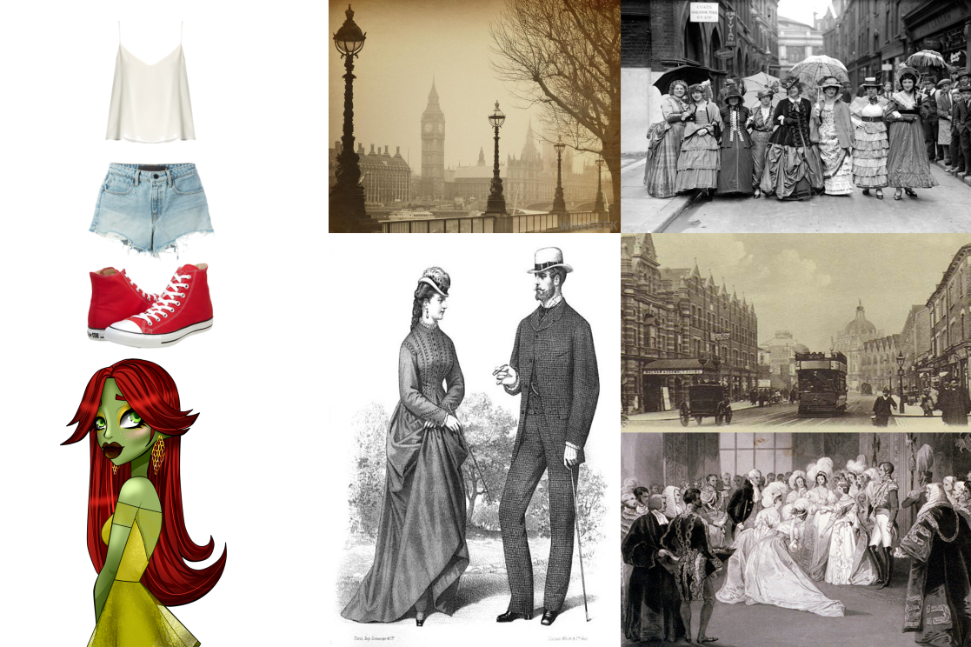
Concept Outline
Vellichor
Monachopsis

Slide 4
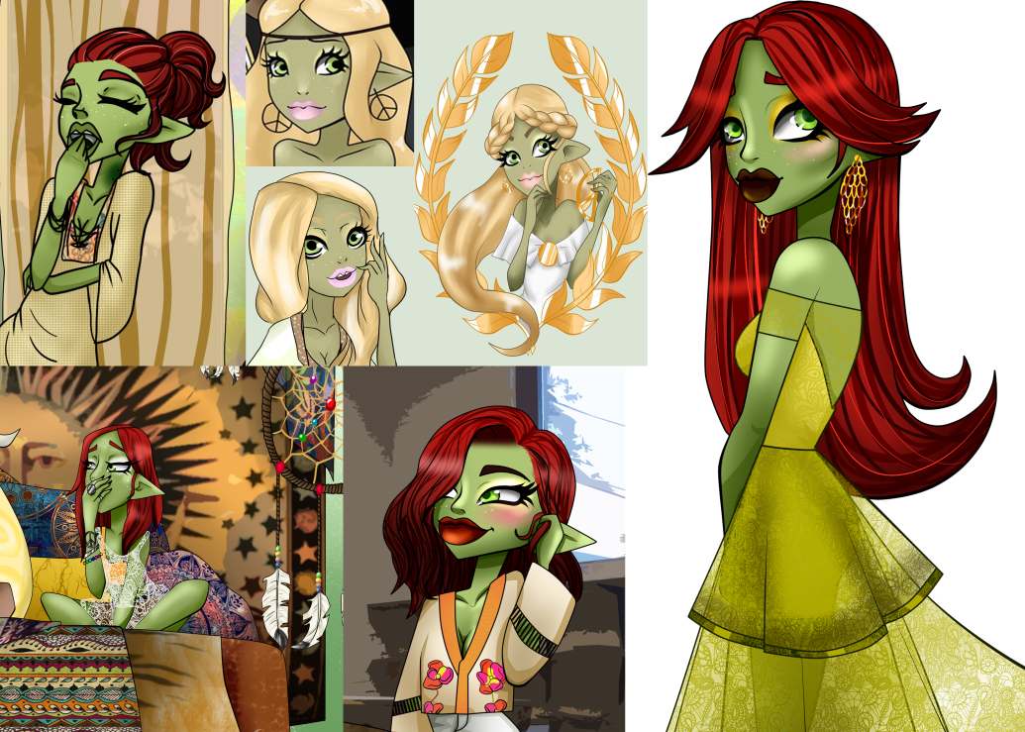
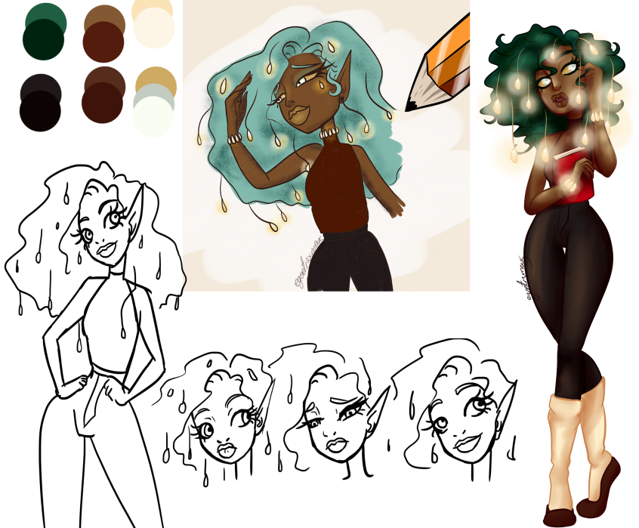
Concept Outline
The protagonist is travelling towards a bookstore that is the only place she feels that she belongs.
When she arrives the owner of the bookstore asks for her help in recovering the missing books which have been stolen by a witch.

Slide 5
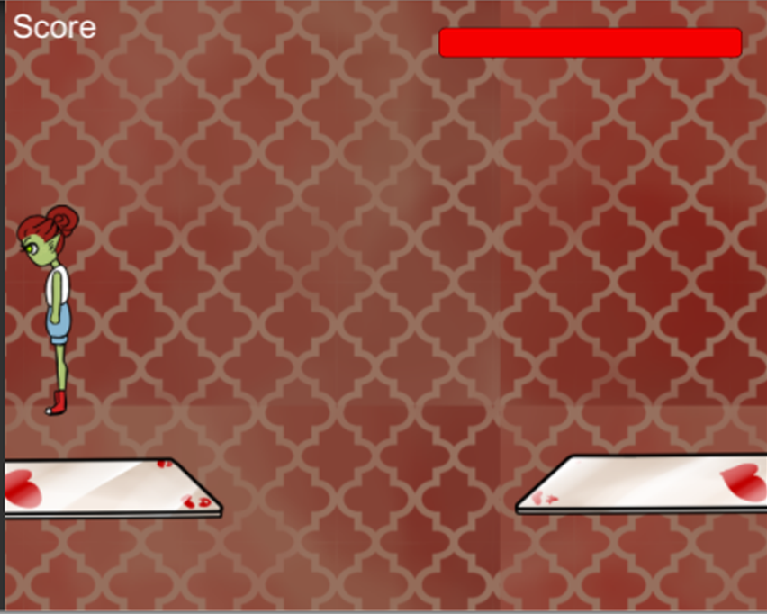

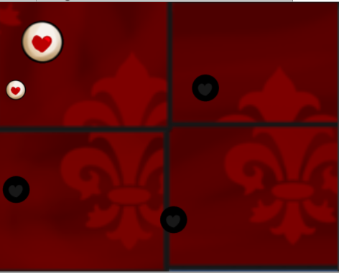
Concept Outline
The player must complete physical challenges to collect book pages, and mental challenges to earn the book covers to return to the book store. In achieving this the player will be rewarded with crystals they can use to open a portal to enter the witches book.

Slide 6
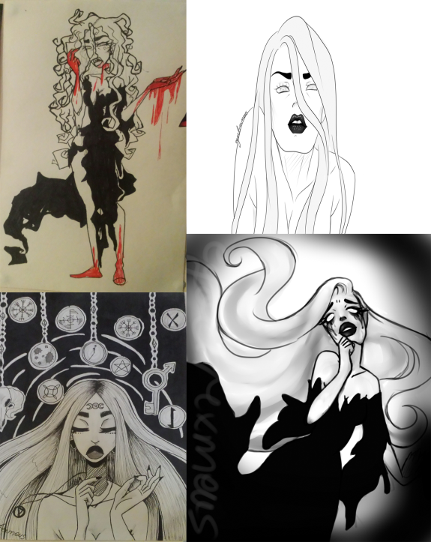
Concept Outline
Once the player has x crystals they will enter a boss battle with the witch.
Once the journey is complete the protagonist will remain at the bookstore, somewhere they finally belong.

Slide 7
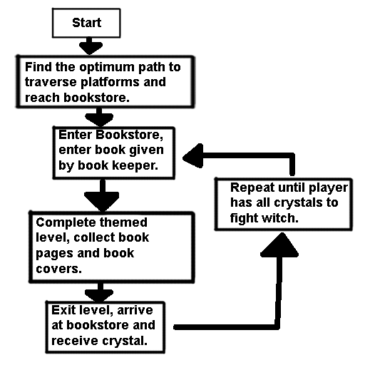
Game Flow Chart

Slide 8
Mechanics
Movement.
Jumping
Collecting book pages
Accurately judging distances for jumps between platforms.
Twitch/precision skill.
Spatial reasoning

Slide 9
Dynamics
Spatial reasoning mini game.
Take the higher route of platforms for more points.
Take the bottom route for a safer journey, but less points.

Slide 10
Aesthetics
Easy fun, serious fun and hard fun.
Mental challenge of spatial reasoning mini game.
Monachopsis is promoted by the use of book themes to which the protagonist does not belong.
Vellichor is promoted by the scene in the bookshop where the player begins/ends the game.

Slide 11
Future Plans
To add multiple levels each themed around a different book. E.g. Dr Jekyll and Mr Hyde.
To evolve the mental challenges to promote the obscure sorrows, and the theme of the level.

Slide 12
Play Testing Results

Slide 13
Sprint Information
Hours Logged
Nathaniel:36
Henry:36
Alex:18
Heather:36
Emails Sent
Nathaniel:23
Henry:22
Alex: 15
Heather: 37

Slide 14
Questions?

